Slide 1
Job and capabilities in Social Solidarity Economy
In collaboration with
3rd December2024
Soana Tortora - coordinator of Solidarius Italy

Slide 2
Networking and development of solidarity and community economies placed based in urban and rural areas
Local participatory development starts from communities and comes back to them
Community
Solidarity and community placed based economies
Networking
Notes:
It’s a big and general topic, so we need to start from the terms we used in order to make concrete and focus better our intervention

Slide 3
Networking and the development of solidarity and community economies placed based in urban and rural areas…
Solidarity and community economies
From latin: Solidus – for the Romans, it indicated the obligation assumed by a person, belonging to a group of debtors, to pay the debt→ this person was closely bound to others (interdependence link to the munus).
Communities as vectors of economic transformation
Social Solidarity Economy
Economic, enviromental and social sustainability
Collaboration VS competition
Enhancing territories
Enhancing people

Slide 4
Networking and the development of solidarity and community economies placed based in urban and rural areas…
Enhancing territories
(in urban and rural areas) :
Enhancing people
valorizing capabilities instead skills: focus on the abilities and capacities of a person, that include also needs, desires, expectations and are strongly linked with “Substantial freedoms” that everyone has and that also depend on the (social, cultural and political) context in which they live (Ref. Sen and Nussbaum)
creating job opportunities: with decent work that values the person as a whole
working on social inclusion
territories as heritages VS exploiting logic
territories as places of freedom where the development of individuals goes hand in hand with the development of living places

Slide 5
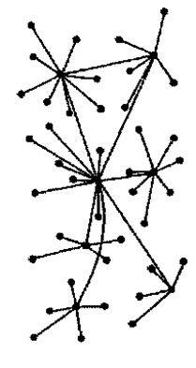
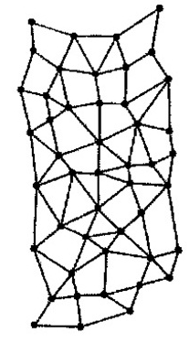
Networking and the development of solidarity and community economies placed based in urban and rural areas…
Networking
Communities as vectors of social, cultural and political transformation
To go beyond the local dimension and the specific sector
To share know how, skills and tool (training)
To share actions (social design)
To do advocacy

Slide 6
Networking and the development of solidarity and community economies placed based in urban and rural areas…
AUTOPOYESIS: an open, self-reproducing system
INTENSITY: each node must reach the largest number of people in its territory
EXTENSION: ability to expand into other territories to give rise to other nodes
DIVERSITY: creativity and involvement of other actors (including institutional ones)
INTEGRALITY: all the objectives of each node must become common objectives
RE-POWERING: actions generated by the network must provoke new ones
From «La Rivoluzione delle reti» Euclides Mance

