Slide 1
Social Solidarity Economy The Impact of Social Enterprises
Dr. Karl Birkhölzer, Interdisciplinary Research Group Local Economy.
Technologie-Netzwerk Berlin e.V.
Berlin 29th of May 2013

Slide 2
A Social Movement for Alternative Economies with a Variety of Names
Social Economy: économie sociale / F / EU – CMAF: Co-operatives, Mutuals, Associations, Foundations – Social Economy Europe – CIRIEC
Solidarity (-based) Economy: économie solidaire / F / Quebec – economia solidaria / Lateinamerika – RIPESS – ASEF/SE Asia
Community Economy / Enterprise / Business: GB / IRL – Commonwealth / COMMACT
Third Sector / NGOs – NPOs / Civil Society: ISTR – Johns Hopkins Project – Zivilgesellschaft in Zahlen / Bertelsmannstiftung
Third System: tertia systema / I – EU / TSEP
Social Enterprise: Legal frameworks in GB / I – EMES – BEST/D – Social Enterprise Coalition / GB a. o.
Social Co-operative: Legal frameworks in I / PL – Sozial-/Stadtteilgenossenschaften / D
Social Entrepreneurship: USA – Ashoka – academic institutes D / DK / GB o.a.
Social Business: M. Yunus – EU/SBI
People‘s Economy / People-Centred Development: economia popular / Lateinamerika / Illich / Razeto / Max-Neef – PCD/SE Asia

Slide 3
Historical Background
The SSE is based on a tradition of more than 150 vears:
Four major strands of development:
Economic self help in the tradition of the co-operative and mutual assistance movement
Charitable help ‘for others’ in the tradition of the social welfare organisations
Philanthropy in the traditions of donations and foundations
Voluntary action in the tradition of volunteering and community associations

Slide 4
Common Characteristics: A Working Definition
Formally established economic activities to achieve primarily social and/or community oriented objectives
Setup, run and controlled by initiatives of citizens or other civil society organisations to serve unmet needs and/or solve conflicts
The economic performance is subordinate to the social and/or community oriented objectives by statutory agreement to work not-for-private-profit and reinvest the surplus in the overall objectives
The organisational structures are based on co-operative or collective principles

Slide 5
Theoretical Background: Concept of a Pluralistic Economy
The economy is understood as a system of means to serve people‘s needs
These means of production vary considerably in different historical and cultural context
At present we can identify al least four major economic systems according to their dominating principles:
A first system – for private profit
A second system – for public service (redistribution)
A third system – for social profit resp. the common good
A fourth (and often neglected) system – the informal or shadow economy

Slide 6
Historical Approach (Max Weber)
European economies are seen as ‚mixed economies‘ combining market and state principles (first and second system)
But there has always been an ‘economy in the shadow‘ which is increasing in times and areas of economic crises
The Social Solidarity Economy resp. Third Sector is a way of economic self help ‚out of the shadow‘:
- from competition to co-operation
- from individualism to solidarity
- from informality to visibility

Slide 7
Understanding Sustainabilty
Diagram: Sustainability triangle
environmental
objectives or needs
SOCIETY or
CUMMUNITY
economic activities
..as a set of means..
social objectives
or needs
cultural objectives
or needs

Slide 8
The Emergence of Social Enterprise
In times and areas of economic crises people gather around unmet needs and/or unsolved conflicts
People start protesting and campaigning: others should meet the needs or solve the problem
People decide to take over responsibility by themselves, embark on economic self help and become social entrepreneurs
-

Slide 10
Main Fields of Activity for Social Enterprises
- Serving basic needs like food and housing
- Decentralised technical systems for energy, transport,
water supply and disposal
- Proximity or neighbourhood services of all kind
- Cultural activities and cultural heritage
- Leisure and recreation services
- Environmental protection, prevention and repair
- Municipal infrastructural services

Slide 11
The Local Social Economy
Social enterprises are mostly committed to local/community problems, but these problems are not always solveable at local level
They need to have strong roots in the community, but also co-operative relationship on regional, national and international level
Scaling up: by replication (strawberry strategy) and co-operation on higher levels (networks, consortia, partnerships, social franchising)

Slide 12
Strategies for local economic development
- Developing a local economic action (business) plan
- Creating production and value chains (local economic cycles)
- Watching the money flow in the community
- Increasing the money exchange within the community
- Using non-monetary exchange systems like LETS, SEL
and others

Slide 13
Building and Improving Social Capital
Communities in economic crises areas are characterised
by a shortage of financial and physical capital
But human as well as social capital is often
underemployed:
- Mobilising the untapped capacities of local people
- Investing voluntary work of citizens
- Improving Social Coherence

Slide 14
Social Capital Indicators
Level of trust
Size and quality of reciprocity and mutual exchange
Existence of generally accepted norms of behavior
Strength of community identity and committment
Numbers and quality of social (formal and informal) networks
Quality of information channels within and outside the community

Slide 15
Community Centred Development
- Re-building the social and/or community infrastructure
is a precondition of successful local economic
development
- Local economic development has therefore often to
start with apparently non-economic activities
- A programme of local economic development should
be developed in three phases of
- firstly community building
- followed by further community development
- and finally establishing a working community economy

Slide 16
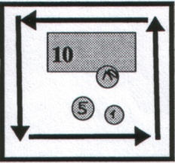
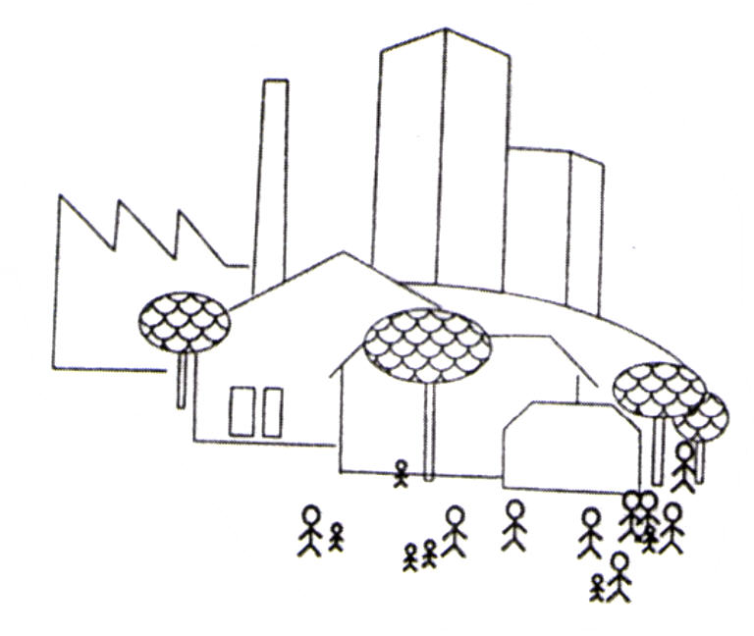
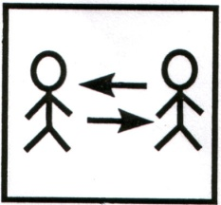
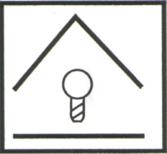
CONCEPT FOR A PROGRAMME OF LOCAL ECONOMIC DEVELOPMENT
1. Analysis of local economic and social structures
9. Social financing resp alternative financial instruments
2. Popular planning processes involving those affected at all levels
8. Promoting new forms of social and/or community-oriented enterprises
3. Building decentralized promotional and support facilities
7. Social marketing resp new relations between producers and consumers
Community
4. Fostering decentralized networks
6. Public development centres for project development and innovation
5. Counselling, education and training for economic self-help
© Technologie-Netzwerk Berlin e.V., Berlin 2005

Slide 17
Societal benefit of Social Enterprises
- growth of employment opportunities in general
- growth of employment opportunities for women, elderly, disabled, migrants
- main actor in active labour market schemes
- main actor in the fight against poverty and social exclusion
- main actor in local development
- socially added value by serving goods and services in socially or locally restricted markets

Slide 18
Future Perspectives
Another economy is possible: Local, social, sustainable
vs. TINA (‘There is NO Alternative’)
Future challenges:
- increasing visibility
- developing alternative microeconomic strategies for social
enterprises
- establishing intermediary services for the sector
- promoting special vocational as well as academic education and
training
Reference: Local Social Economy Learning Package
(www.Cest-transfer.de)

Slide 19
Further Information: Dr. Karl Birkhölzer k.birkhoelzer@technet-berlin.de www.technet-berlin.de www.Cest-transfer.de

