Slide 1

Day 4:
Part 2 – From knowledge to analysis: managing
a participatory process

Slide 2
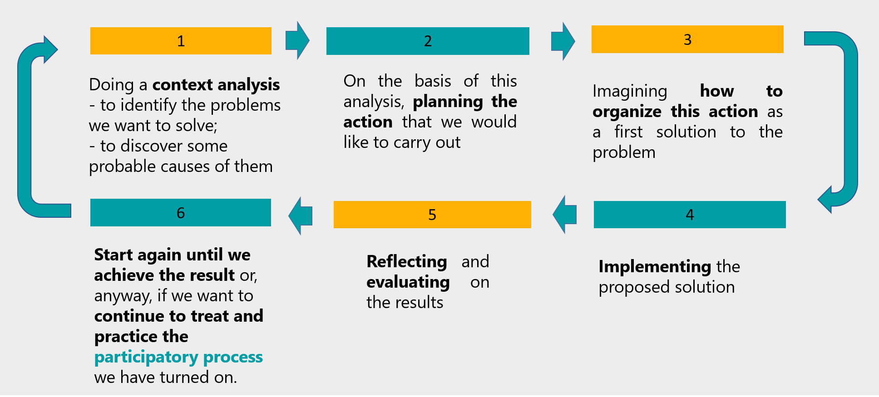
ACTION RESEARCH METHODOLOGY: THE NEXT STEP
After making a context analysis and knowing something more of out territory and people who are livining in, the action research goes on, while the transformative process is in act
People who partecipate to the action research are changing
The reality where we are working is changing
IN ACTION RESEARCH THE CHANGE DOESN’T HAPPEN AT THE END OF THE PROCESS, BUT THROUGHOUT

Slide 3
ACTION RESEARCH: PLAN, DESIGN, ORGANIZE
In this process – in each step - the actors can take place at different levels and with different roles on the basis of their competences, knowledges, abilities, vocation, personal availability.
It’s important to realize the conditions to co-imagine, co-design and co-plan this process with all people involved:
  trainers
  trainees
  trainees’ families
  VET providers
  Others educational agencies
  Local business and companies (involved in SSE or not)
  Local and national institutions
BUILDING PARTICIPATION

Slide 4

ACTION RESEARCH: a participatory process
How can we ensure that the number of (actors) action-researcher is as large as possible and as representative as possible of their reality and experiences?
It’s really difficult to involve all actors and stakeholders at the same time: which people do I decide to involve first? What criteria do I use to choose them?

Slide 5
ACTION RESEARCH: a participatory process
How can we welcome the actors to involve with their characteristics, experiences and differences?
What tools and methodologies can we use to ensure participation?

Slide 6

TRAINERS IN A TRAINING IN ACTION COURSE
What role should the trainer play in this process?
How can we recognize new skills to the trainers without necessarily creating a new professional profile in charge of this process?
OR
VET and SSE TRAINERS TO BUILD A TRAINING COMMUNITY
ORIENTED TO COMMON GOOD AND SUSTAINABLE LOCAL DEVELOPMENT

