Slide 1


Day 4
Intellectual Output 2:
Training in action course
Strengthening VET trainers’ competences
on the Social Solidarity Economy

Slide 2

A work in-progress during 2 years…
Who is this training-in-action course for?
This document is a tool for VET trainers and trainers from SSE organisations. It aims at constructing a training in action course that will stimulate and support trainers during their activity. It can equally serve as a reference for other professionals operating at different levels of the training and education system, interested in the SSE field.
This course is also useful for people, organisations and enterprises working in the SSE field and who have an interest in developing training courses pursuing SSE principles and values.

Slide 3
Training in action course

Slide 4
Training in action course
There are two main characteristics of the course we have designed and on which we would like to collect your ideas or issues, based on the training experience that you lived
THE TRAINING COMMUNITY
THE ACTION RESEARCH
During national pilot trainings we have had many ways of creating a training community and making action research
Now, with the health emergency, we need to rethink these crucial elements of our work asking ourselves above all how this training in action can maintain its characteristics even at a distance

Slide 5
Training in action course – Training Community
Creating a training community is a process that requires time and above all CARE
Care is a core notion in SSE emphasizing the reciprocal responsibility to provide a great attention to fair participation, well-being and safety feelings
Care is the ingredient at the basis of an emerging learning community
TO CREATE A TRAINING COMMUNITY :
AMONG THE TRAINERS WHO DECIDE TO PARTICIPATE IN THIS PROCESS AS TRAINEES
BETWEEN TRAINERS AND TRAINEES
“ No one educates anyone, but we all educate ourselves in the community” (Freire P. 1970)

Slide 6
Training in action course – Training Community
A PEER COMMUNITY DURING ALL THE TRAINING PROCESS→ FROM THE DESIGN TO THE EVALUATION
TRAINING PATH
PARTICIPATORY LEARNING
TEAM SPIRIT
CAPABILITY APPROACH
THE ROLE OF THE TRAINER

Slide 7

Training in action course
But it’s not enough for us!
When we are in a training in action process we have to keep in mind the importance to involve other people that can be interested and can became part of the process.
We have to have an inclusive perspective that maybe starts in a classroom (virtual or not) and spreads out, goes outside.
  TRAINERS
  TRAINEES
  TRAINEES’ FAMILIES
  VET PROVIDERS
  OTHERS EDUCATIONAL AGENCIES
  LOCAL BUSINESS AND COMPANIES (INVOLVED IN SSE OR NOT)
  LOCAL AND NATIONAL INSTITUTIONS
  ……

Slide 8
Training in action course – The Action Research
TRAINING IN ACTION
ACTION RESEARCH
Within a path of continuous training strongly anchored to local contexts, the methodology of action research seems the most useful and suitable mode of intervention.
“the task of action research is not to describe the world as it presents itself,
but to be able to outline how it could be“
Arcidiacono C. “Ricerca-azione partecipata e “cooperative inquiry”
(Participatory research-action and "cooperative inquiry”) in “La ricerca-intervento”, a cura di Colucci-Colombo-Montali, Il Mulino Prismi, 2008.

Slide 9
Training in action course – The Action Research
IT’S A CYCLICAL RESEARCH PROCESS → design, research, action, reflection and evaluation are interconnected
IT’S A PARTICIPATORY PROCESS → each step presupposes the participation of the actors involved: those that are usually defined as the recipients become agents of change
IT’S A TOOL OF TRASFORMATION →It’s used in academic contexts, but it’s also a validated methodology of social action. Research does not separate itself from action, but becomes action itself

Slide 10
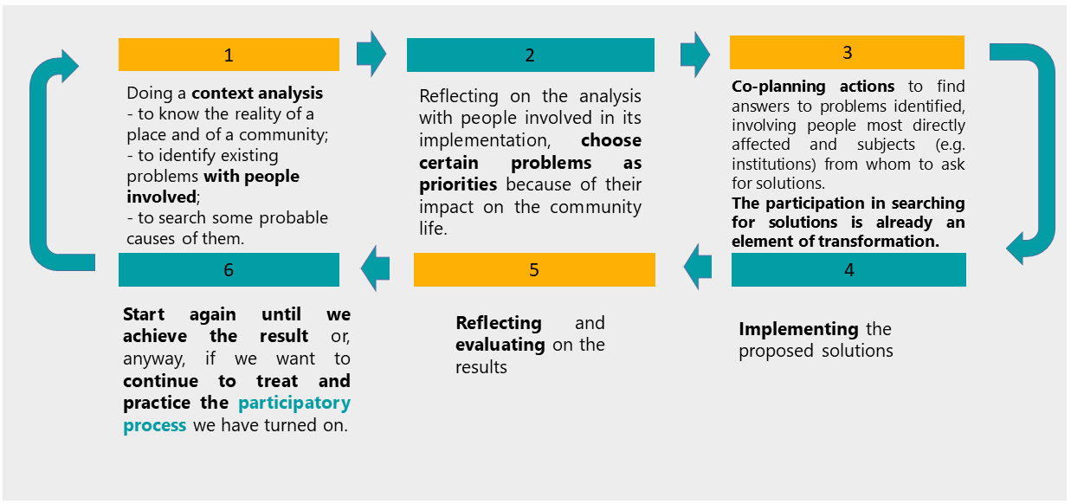
Training in action course – The Action Research
CONTEXT ANALYSIS
TO CO-PLAN /
TO CO-DESIGN
COLLECTIVE ACTIONS
BUILDING PARTICIPATION
SELECTION OF THE PROBLEMS
TO REFLECT AND TO EVALUATE

Slide 11

Training in action course – The task for our World Cafè
In attendance
A PEER COMMUNITY DURING ALL THE TRAINING PROCESS→ FROM THE DESING TO THE EVALUATION
TRAINING PATH
PARTICIPATORY LEARNING
TEAM SPIRIT
CAPABILITY APPROACH
THE ROLE OF THE TRAINER
CONTEXT ANALYSIS → TO KNOW LOCAL REALITIES
NEEDS ANALYSIS
INVOLVING A LARGER NUMBER OF PEOPLE THAT GRADUALLY WE MEET IN THE PROCESS
CO-PLAN THE ACTIONS
EVALUATE THE ACTIONS
COLLECTIVE ACTIONS
Training Community
Actio
n Research
At distance
HOW CAN WE DO IT IN THE PRACTICE IN ACCORDING WITH SSE VALUES AND PRINCIPLES?

